Slide 1
Library Collection
Management System
DAO Pattern + File Persistence | Java Swing
Term II Project | IEM Gurukul | Object Oriented Programming using Java

Slide 2
Problem Statement
The Challenge
The Solution
Libraries using manual methods struggle to maintain accurate records.
Tracking book availability and stock is error-prone without a system.
Borrowing and returning transactions are hard to record consistently.
Data inconsistencies make locating books difficult.
A desktop-based Library Collection Management System built with Java Swing.
Implements DAO Pattern for clean separation of data access logic.
File Persistence ensures data is never lost between sessions.
Layered architecture for maintainability and scalability.

Slide 3
Core Features
📚 Book Management
🔄 Borrow & Return
🔍 Search & Filter
Add, Edit, Delete books with full form validation
Tracks copies, prevents borrow when unavailable
Search by title, author, or ISBN instantly
⚠️ Low Stock Alert
💾 File Persistence
✅ Input Validation
Highlights books with quantity at threshold
Auto-saves to books.dat — no data loss on close
Error messages and confirmation dialogs

Slide 4
OOP Concepts Used
Abstraction
BookDAO interface hides implementation details from UI and Service layers
Encapsulation
Book.java fields are private; accessed only via getters and setters
Polymorphism
BookDAO dao = new BookDAOImpl() — interface type, concrete object
Inheritance
MainFrame extends JFrame, BookTablePanel extends JPanel
Exception Handling
FileNotFoundException, ClassNotFoundException, business rule violations
Collections
List<Book>, ArrayList, Java Streams for search and filtering
Design Pattern
DAO Pattern — isolates all file I/O inside BookDAOImpl

Slide 5
System Architecture
UI Layer
MainFrame · BookTablePanel · BookFormPanel · SearchPanel
Service Layer
BookService — validates input & enforces business rules
DAO Layer
BookDAO (interface) · BookDAOImpl (file read/write)
Persistence Layer
books.dat — binary file saved via ObjectOutputStream

Slide 6
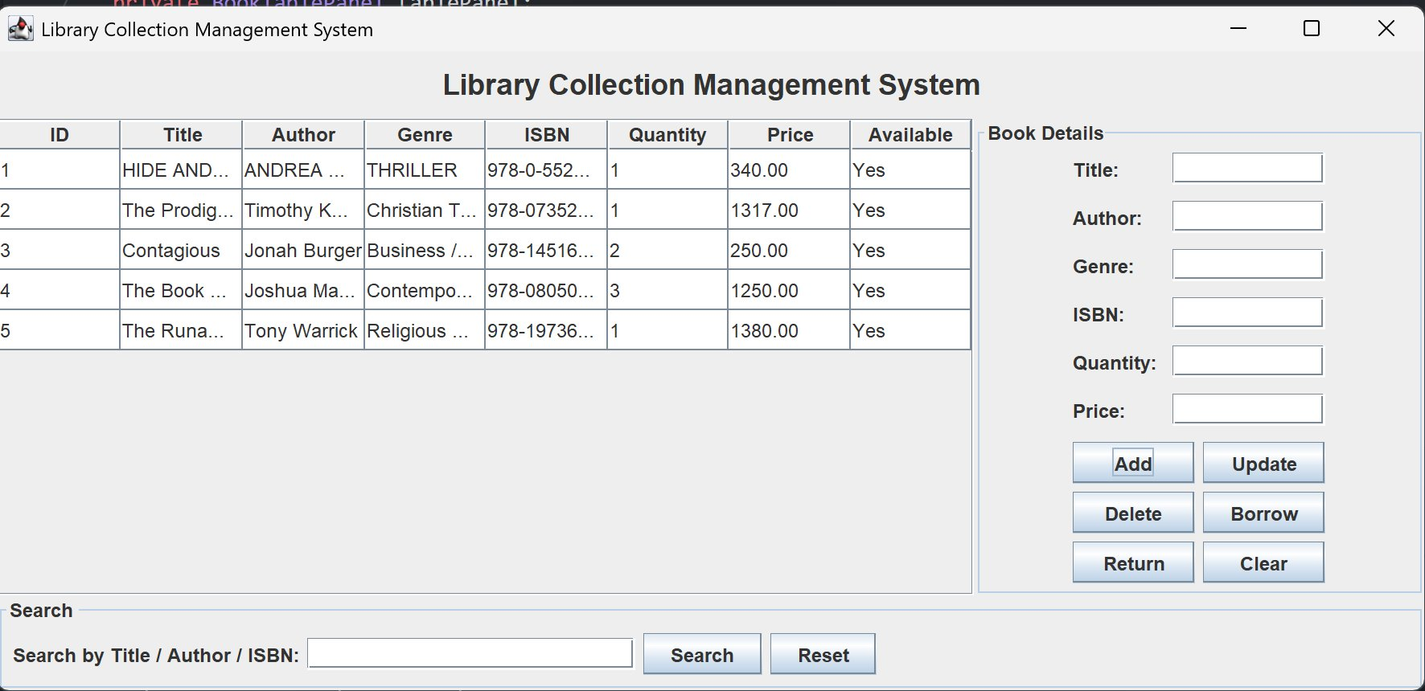
Application Screenshot

Slide 7
How to Run
Clone the Repository
1
git clone https://github.com/IEM-Gurukul/term-ii-project-submission-Elixer05.git
Navigate to src folder
2
cd term-ii-project-submission-Elixer05/src
Compile all Java files
3
javac *.java
Run the application
4
java Main
Prerequisite: JDK 17 or above must be installed

Slide 8
Thank You

